Slide 1


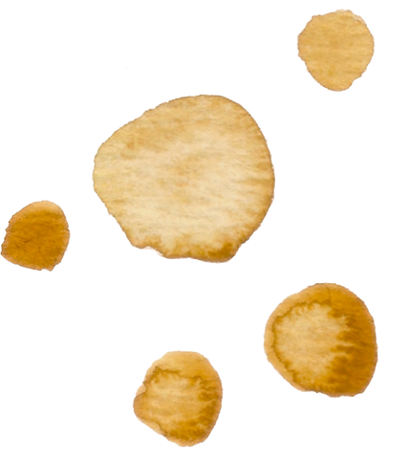

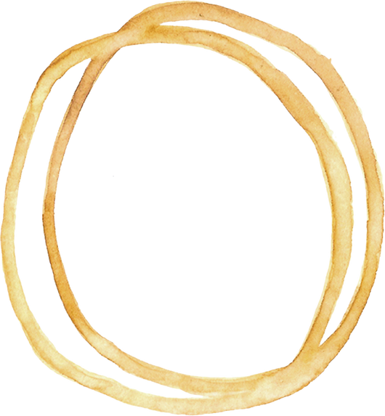


TELECOM CHURN ANALYSIS

Slide 2

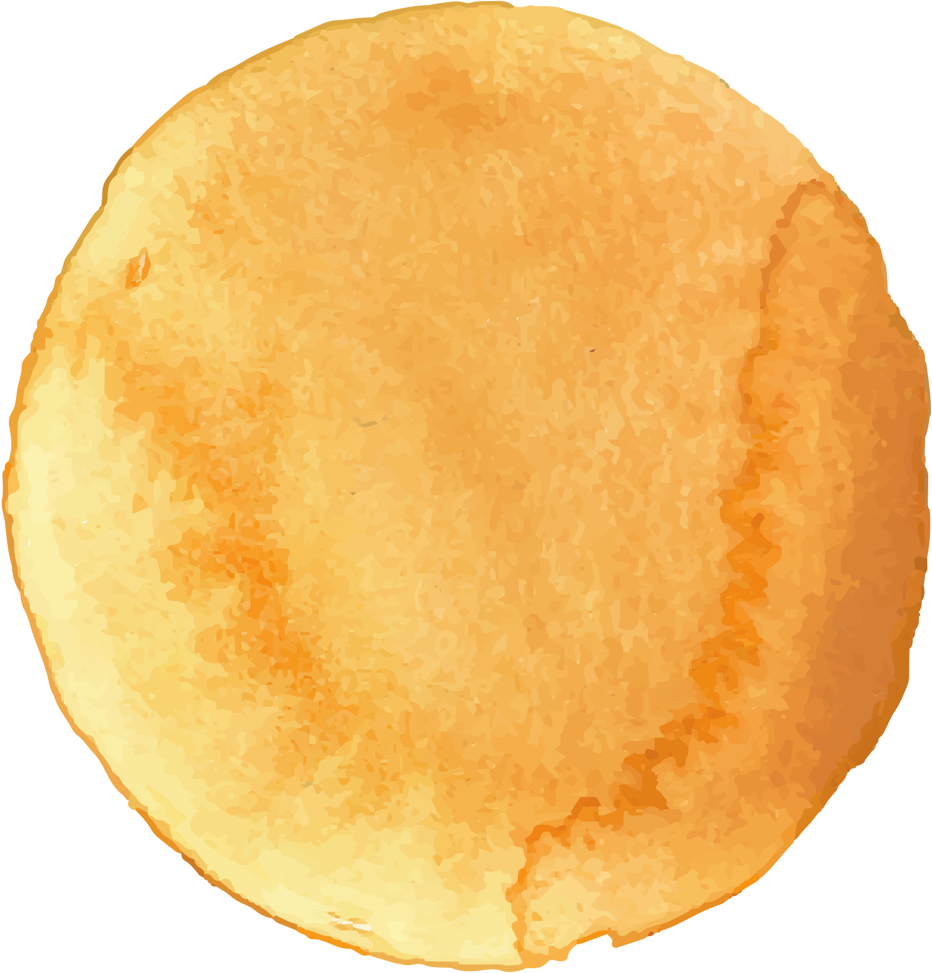




PROBLEM
The key challenge is to predict if an individual customer will churn or not. A side question will be, which features actually drive customer churn. That information can be used to identify customer “pain points” and resolve them by providing goodies to make customers stay

Slide 3
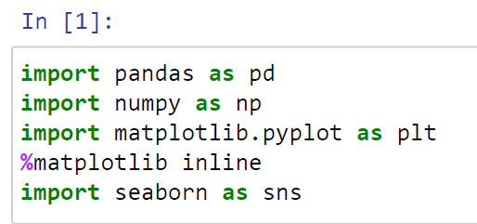
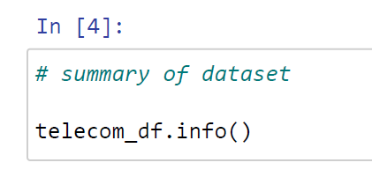
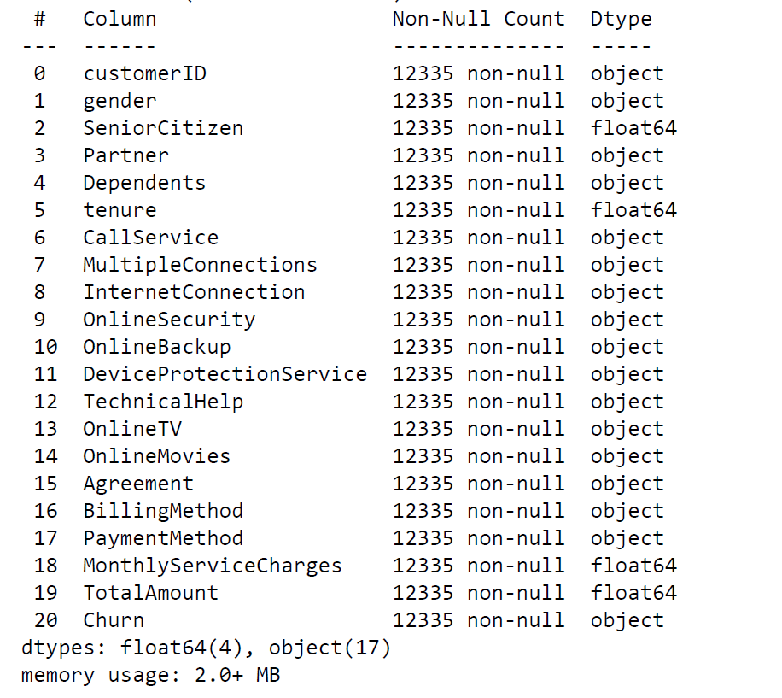
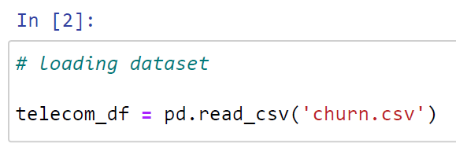
Importing Libraries & Dataset
Importing Basic Libraries
Summary of Dataset
Summary of Dataset
Majority of the columns in the dataset are of “object” datatype
Importing DataFile

Slide 4
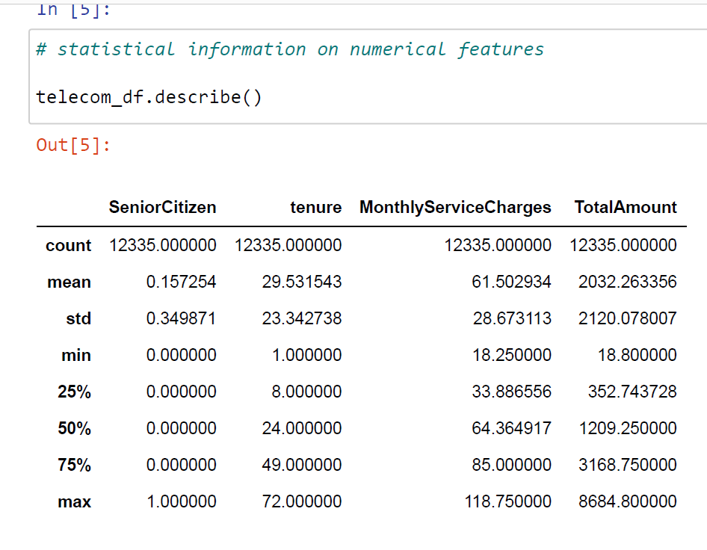
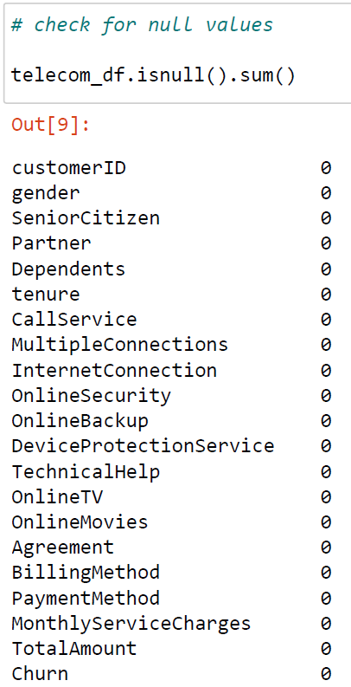
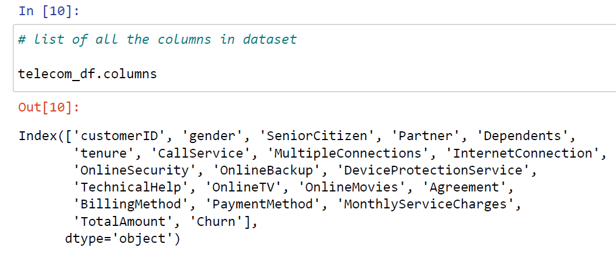
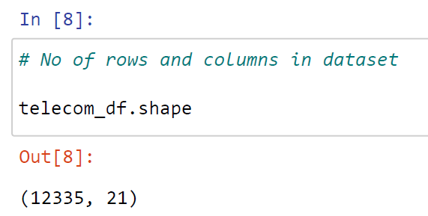
Data Cleaning
Statistical Summary
Null Values Check
No null value present in dataset
List of Columns in Dataset
Shape of Dataset

Slide 5
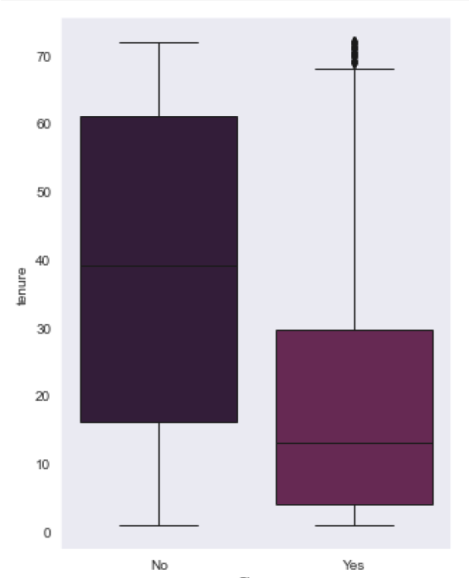
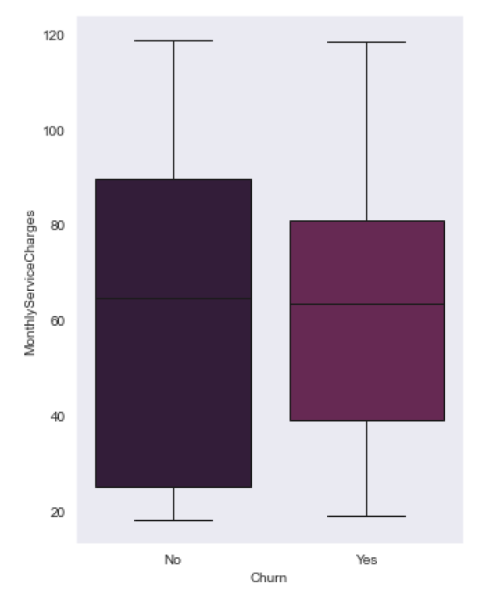
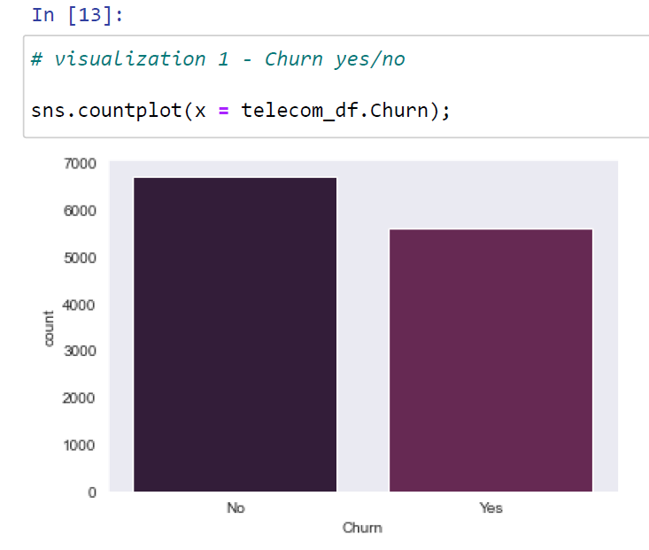
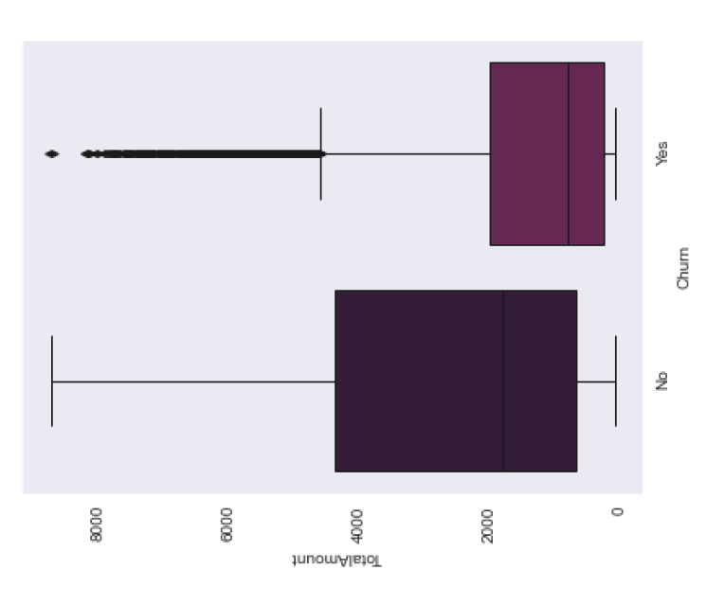
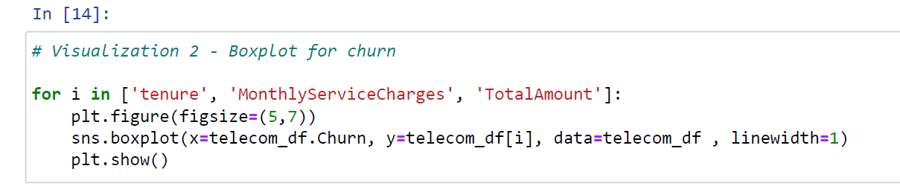
Data Exploration
Check whether Dataset is Balanced or not
Dataset is balanced
1.Churning customers have a lower tenure of median ~ 18 months compared to 58 months for non churners
2. No significant difference observed in monthly charges observed for churners and non churners
Box Plot

Slide 6
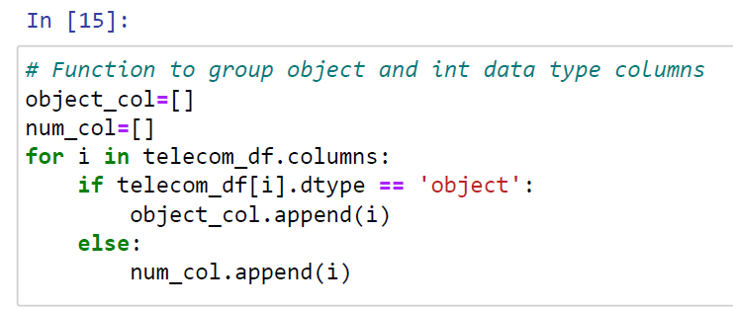
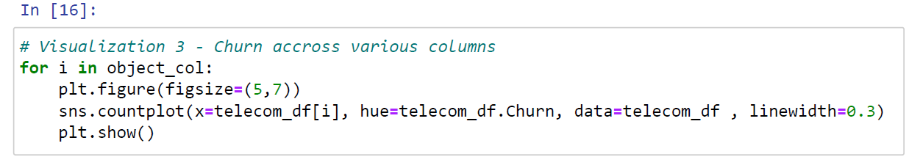
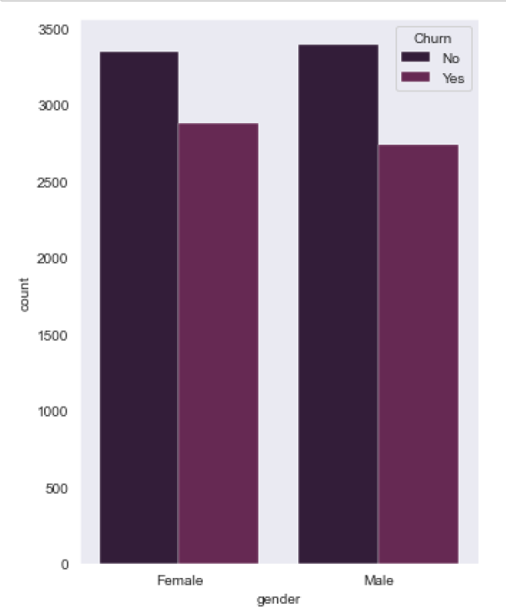
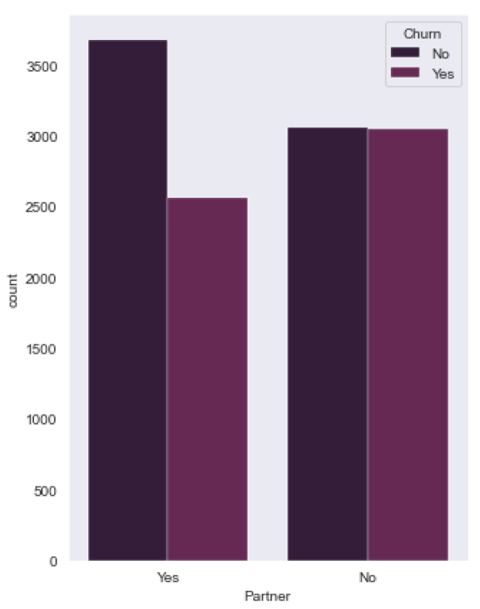
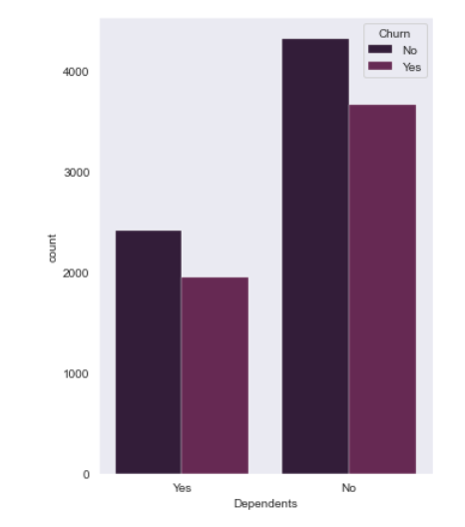
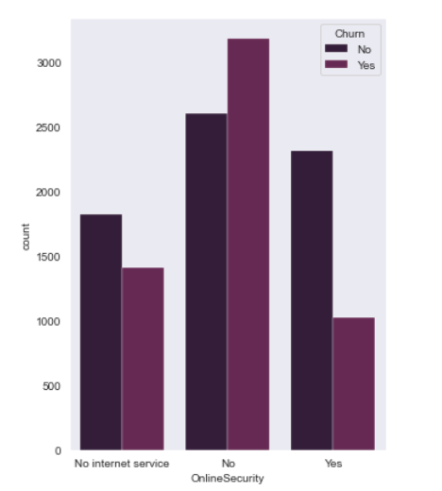
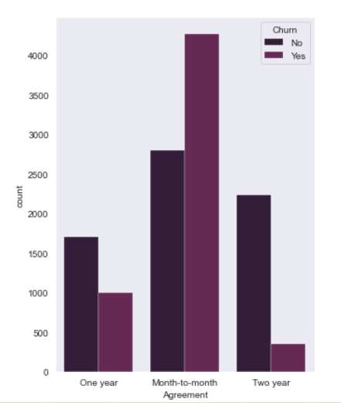
Data Exploration
1. Gender does effect the churn rate; male and female has similar churners and non churners
2. Customers with partners have high churn rate comparatively
3. Customers without dependents have a high churn rate than those with dependents
4. Customers without online security have a very high churn rate
5. Customers in a month to month agreement have a very high churn rate
Other Factors affecting Churn Rate

Slide 7
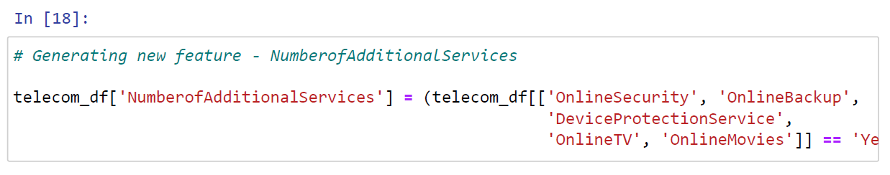
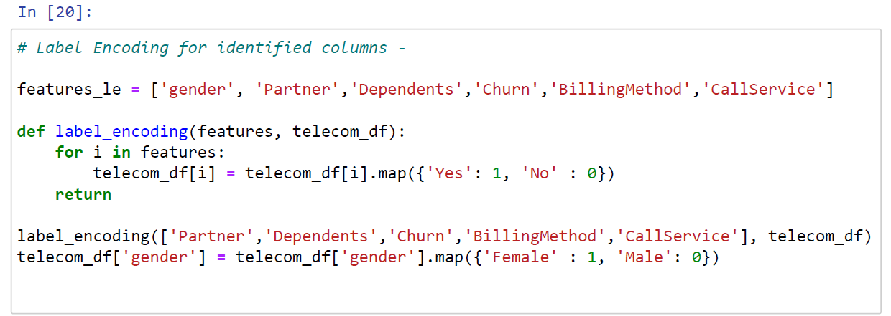
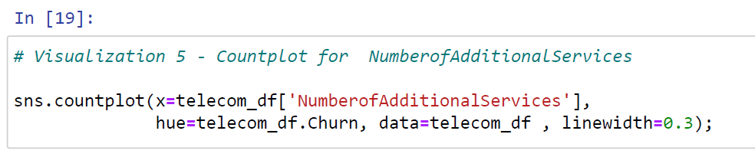
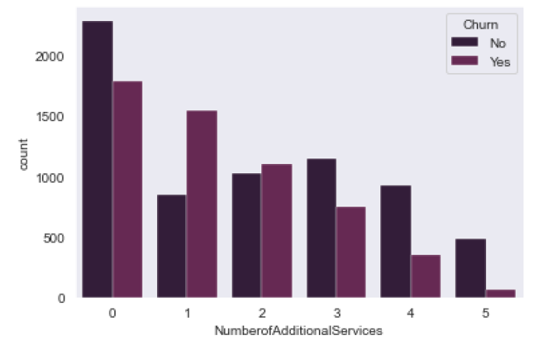
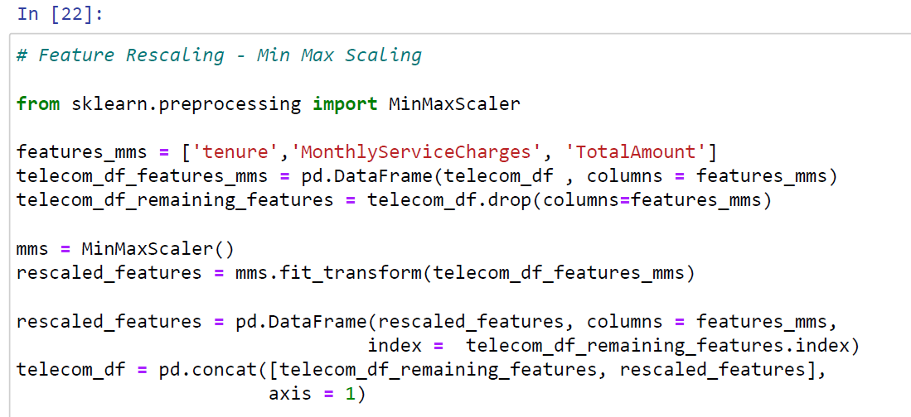
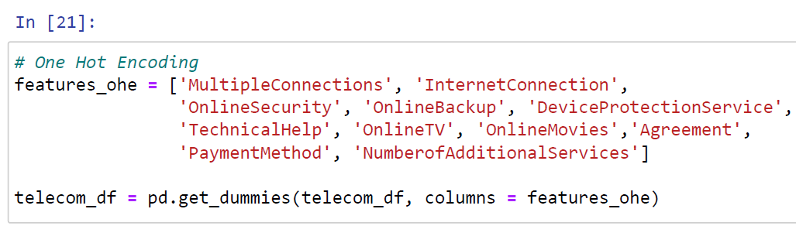
Feature Engineering
Converting object datatype columns into binary
New Feature Generation
Label Encoding
Min-Max Scaler used to standardize and normalize the data
It was observed customers with 0 additional services have a high churn rate
Feature Rescaling
One Hot Encoding

Slide 8
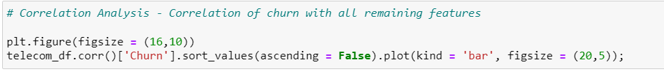
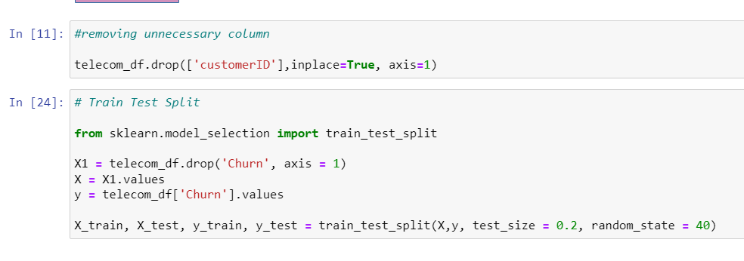
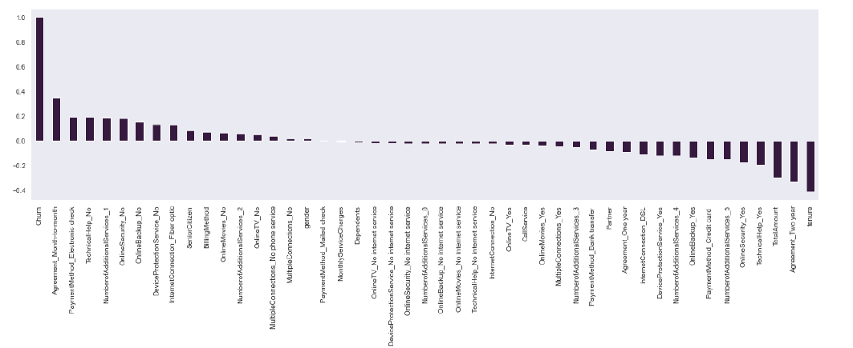
Correlation & Data Splitting
Correlation Analysis
Train Test Split
“Customer_id” column was dropped because it was not required
Target Variable – “Churn”
Data is split into training and testing in the ratio of 80:20
Our previous inference that customers with “Month to Month” agreement have a high correlation with churning, followed by Electronic Method of Payment

Slide 9
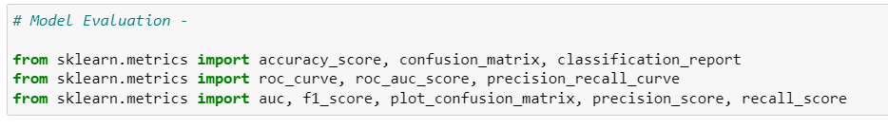
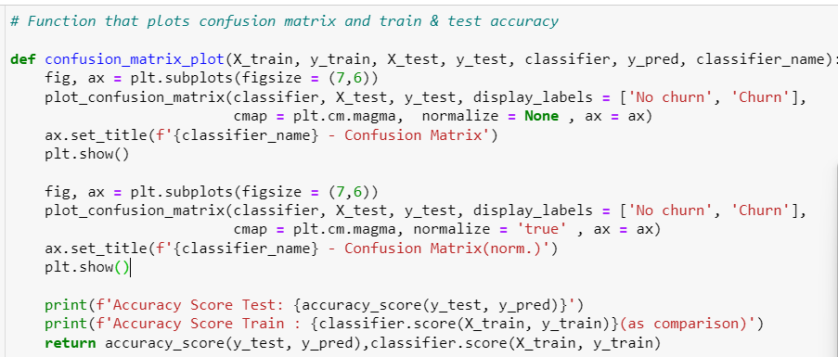
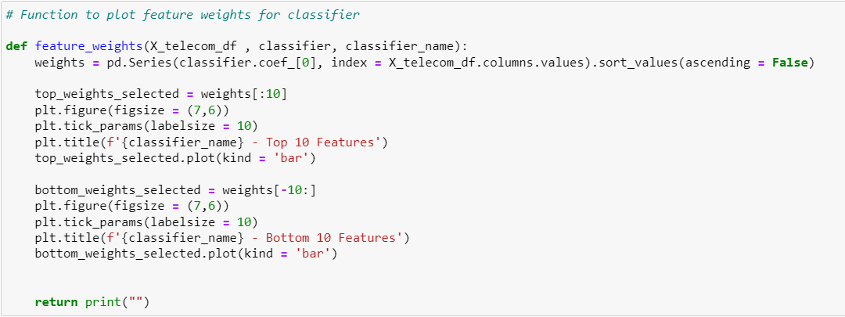
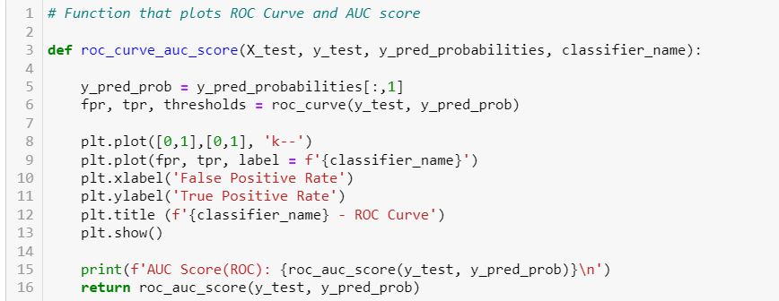
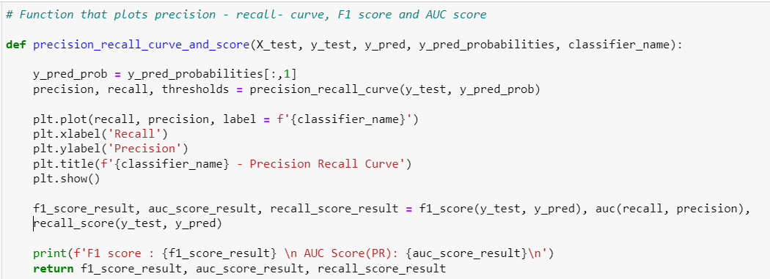
Model Evaluation Metrics
Importing Required Metrics
Function for Confusion Matrix
Function for feature weights
Function for ROC Curve and AOC Score
Feature weights: Indicates the top features used by the model to generate the predictions
Confusion matrix: Shows a grid of true and false predictions compared to the actual values
ROC Curve: Shows the diagnostic ability of a model by bringing together true positive rate (TPR) and false positive rate (FPR)
Precision-Recall-Curve: Shows the diagnostic ability by comparing false positive rate (FPR) and false negative rate (FNR)
Function for Precision Recall, F1 Score

Slide 10

NOW!!!
One Major Question
WHICH MODEL TO CHOOSE??

Slide 11
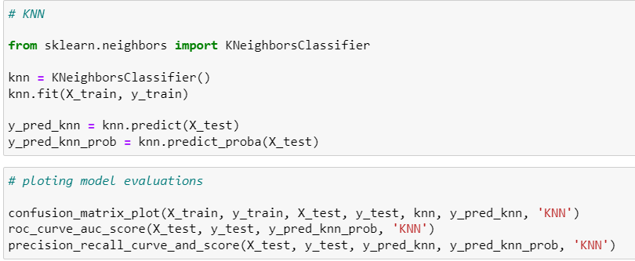
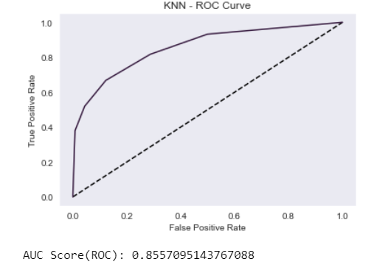
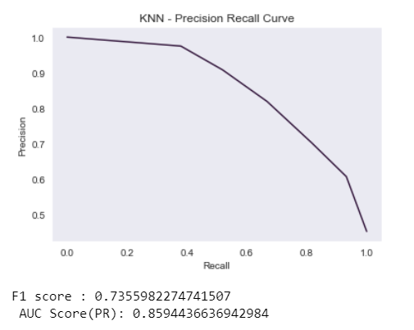
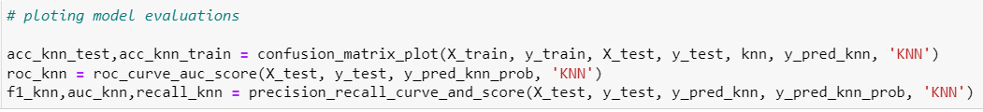
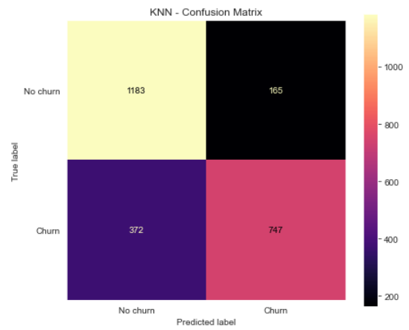
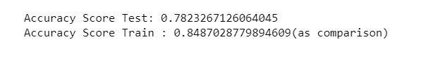
K Nearest Neighbors
The k-nearest neighbors (KNN) algorithm is a simple, supervised machine learning algorithm that can be used to solve both classification and regression problems

Slide 12
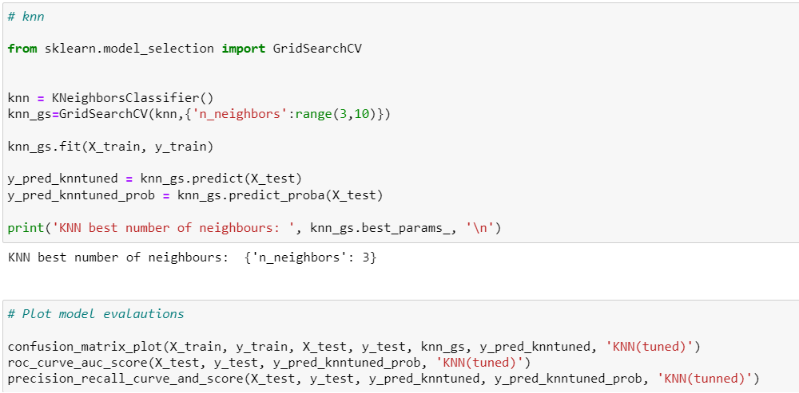
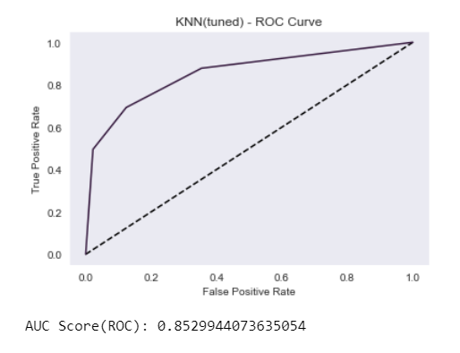
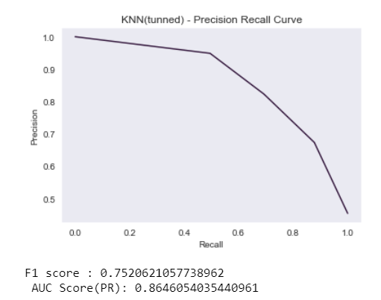
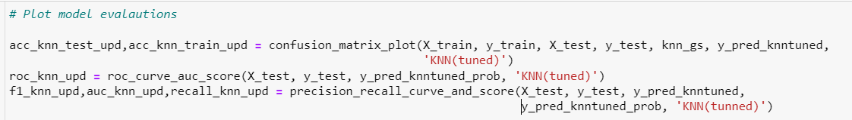
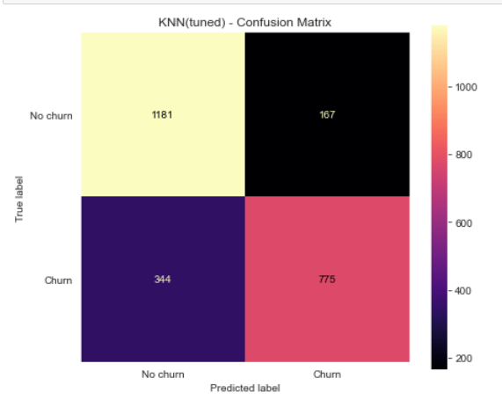
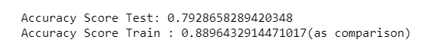
K Nearest Neighbors- Tuned
For KNN GridSearch CV is used to determine the optimal number of neighbors (k) leading to the best model performance

Slide 13
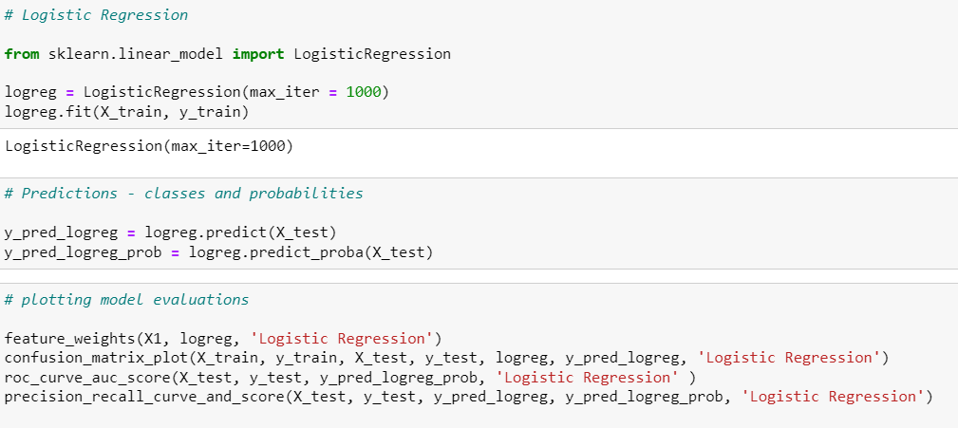







Logistic Regression
Logistic regression is one of the most popular Machine Learning algorithms, which comes under the Supervised Learning technique. It is used for predicting the categorical dependent variable using a given set of independent variables

Slide 14






Logistic Regression - Tuned
For Logistic Regression GridSearchCV is used to determine the best model while applying different values of L1 or L2 regularization to turn the impact of non-meaningful feature to zero (L1) or to simplify the model by relativizing strong patterns that are picked up during training (L2)

Slide 15






Random Forest Classifier
Random Forest is a popular machine learning algorithm that belongs to the supervised learning technique. It can be used for both Classification and Regression problems in ML. It is based on the concept of ensemble learning, which is a process of combining multiple classifiers to solve a complex problem and to improve the performance of the model
Random Forest is a classifier that contains a number of decision trees on various subsets of the given dataset and takes the average to improve the predictive accuracy of that dataset

Slide 16






Random Forest Classifier- Tuned
For the Random Forest model RandomizedSearchCV is used to optimize for several hyperparameters including n_estimators, max_features, max_depth, criterion and bootstrap.

Slide 17






Support Vector Machine
The goal of the SVM algorithm is to create the best line or decision boundary that can segregate n-dimensional space into classes so that we can easily put the new data point in the correct category in the future. This best decision boundary is called a hyperplane

Slide 18






Support Vector Machine - Tuned
For SVM GridSearchCV is used to determine the C value for the optimal margin around the support vector

Slide 19




Summary

Slide 20
Summary
Non Tuned
Tuned
 |  | KNN | Logistic Regression | Random Forest | SVM |  | KNN | Logistic Regression | Random Forest | SVM
Accuracy Score – Train |  | 0.84 | 0.71 | 0.99 | 0.86 |  | 0.89 | 0.70 | 0.99 | 0.71
Accuracy Score – Test |  | 0.78 | 0.71 | 0.88 | 0.84 |  | 0.79 | 0.72 | 0.88 | 0.71
AUC Score |  | 0.85 | 0.80 | 0.96 | 0.91 |  | 0.85 | 0.80 | 0.96 | 0.79
F1 Score |  | 0.73 | 0.69 | 0.86 | 0.81 |  | 0.75 | 0.70 | 0.86 | 0.70
AOC Score( PR) |  | 0.85 | 0.73 | 0.95 | 0.92 |  | 0.86 | 0.73 | 0.96 | 0.73
Good Score: 0.8 - 1
Based on the various model evaluation metrics, it can be inferred that “Support Vector Machine” is the best model to predict churn rate for the given dataset
Average Score: 0.79 – 0.50
Bad Score: 0.49 – 0

